Slide 1

Tech-Hive: Collaborative Online Learning Portal
Tech-Hive connects students and educators, enabling seamless content sharing.
It provides a platform for interactive learning, fostering a dynamic learning environment. Users can access resources, participate in group projects, and collaborate on assignments effortlessly.

Slide 2

Problem Statement
Lack of Engagement
Poor Collaboration
Existing platforms prioritize content delivery but lack meaningful interaction.
Insufficient opportunities for peer-to-peer and teacher-student communication.
Challenges with Self-Paced Learning
Limited tools are available to facilitate interactive, self-paced, and cooperative learning experiences.

Slide 3
Objectives and System Comparison
Goals
Existing Systems vs. Tech-Hive
Facilitate cooperative learning capabilities
Interaction
Minimal
Active student-teacher engagement
Support seamless content uploading
Provide a simple and user-friendly interface
User Roles
Admin/Instructor only
Admin, Teacher, and Student
Content Contribution
Instructor only
Both Students and Teachers
Discussion Forums
Unavailable
Integrated and accessible

Slide 4





Key Features of Tech-Hive
User Registration & Login
Role-based Dashboards
Content Management
Customized interfaces for Admins, Teachers, and Students
Easily upload and access study materials
Secure access with role-specific permissions
Quizzes and Assessments
Certification
Track individual and group performance to monitor progress
Boost engagement with gamified quizzes and challenges

Slide 5



System Architecture
Client Layer
Application Server
Database Server
Users interact with Tech-Hive through web browsers on various devices, delivering the user interface and capturing inputs.
Processes business logic using PHP, manages sessions and authentication, and handles communication between clients and database.
Stores user data and interactions securely using MySQL, ensuring reliable management, fast queries, and data integrity.

Slide 6

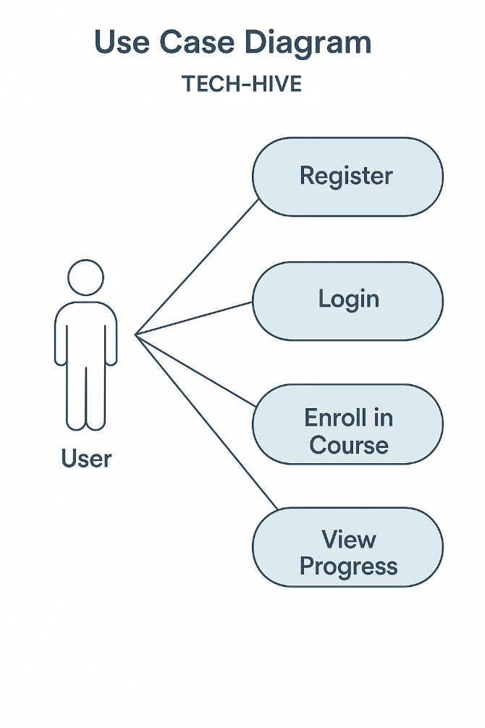
Use Case Diagram
The use case diagram visually depicts the interactions between users and the Tech-Hive system. It highlights the specific actions users can perform and how the system responds. This diagram provides a clear understanding of the system's functionalities and processes from the user's perspective.

Slide 7

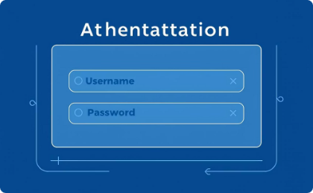

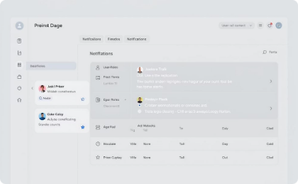



Data Flow in the System
Login & Secure Session
Authentication
Data Retrieval
Personalized Dashboard
User initiates login, establishing a secure session
System validates username and password inputs
System retrieves relevant user data from the database
Dashboard presents personalized info and notifications
Material Upload
Profile & Password Updates
Role-Based Access
Uploads include validation for content quality and standards
User requests for profile and password changes are processed
Users access core functionalities according to roles

Slide 8




Technology Stack
Frontend
Backend
HTML, CSS, JavaScript for user interface
PHP for application server logic
Database
Web Server & Tools
MySQL for robust data management
XAMPP (Apache, MySQL), Bootstrap, Git for version control

Slide 9
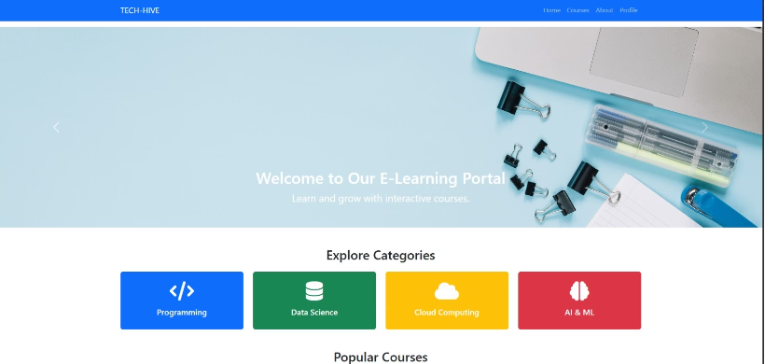
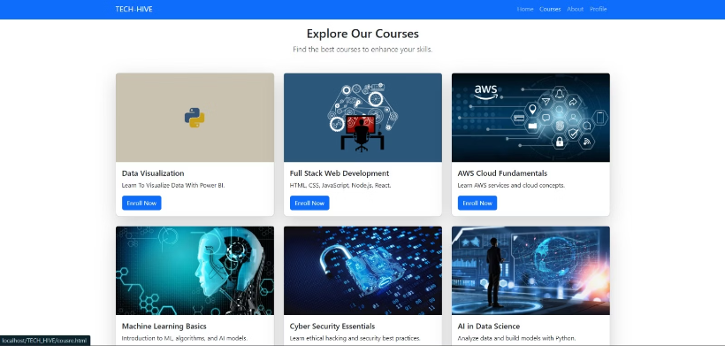
Tech_Hive:ScreenShots
Home Page
Courses Page

Slide 10

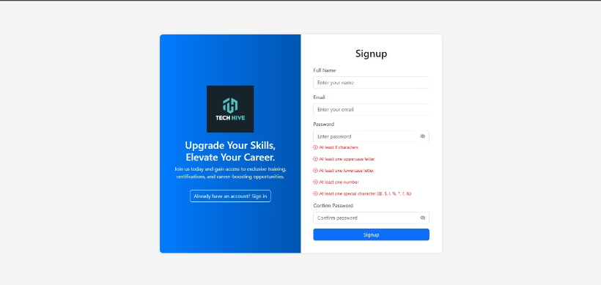
Tech_Hive:ScreenShots
Login page
Sign up page

Slide 11
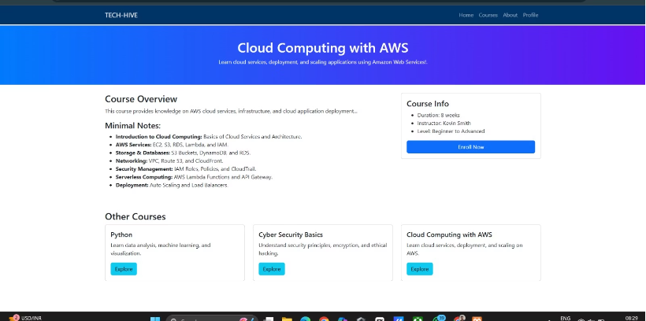
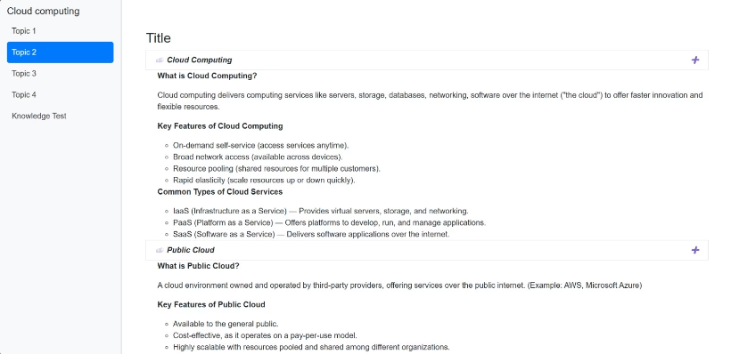
Tech_Hive:ScreenShots
Course overview page
Course page

Slide 12
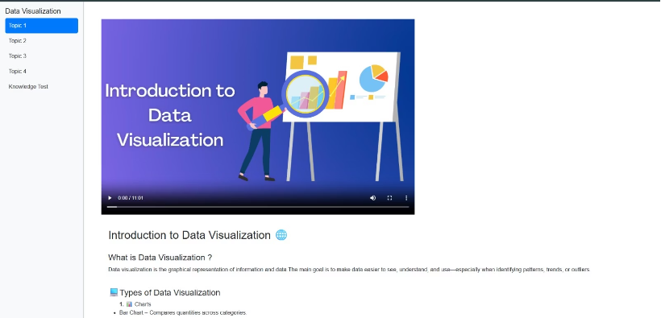
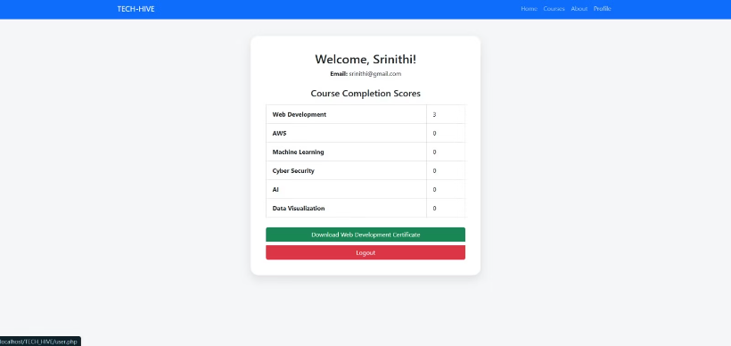
Tech_Hive:ScreenShots
Video Content Page
Progress Tracking Page

Slide 13
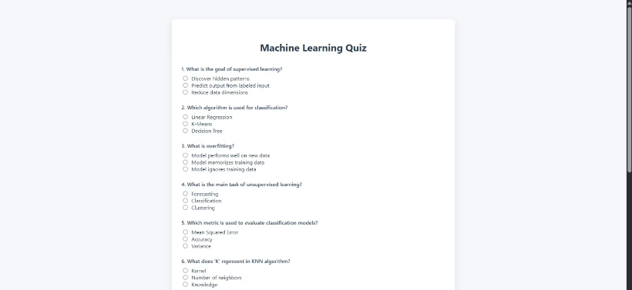

Tech_Hive:ScreenShots
Quiz Page
Certification Page

Slide 14
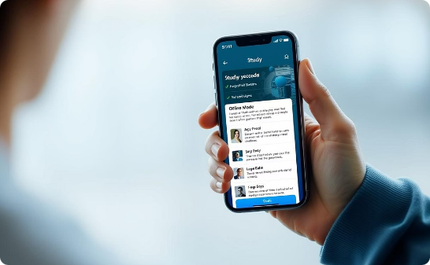


Conclusion & Future Enhancements
Offline Access
Virtual Reality Integration
Industry Partnerships
Learners can study anytime, without internet connection.
Providing immersive and engaging learning experiences.
Connecting students with real projects and job opportunities.

